Slide 1

PUZZLE SOLVER
GROUP 4
SUAIBA BINTE SALAM
MD MARUF RAHMAN
AK FAIZUL HAQUE KONOK

Slide 2

INTRODUCTION
OUR PUZZLE SOLVER IS A PYTHON-BASED PROJECT
IT SOLVES TWO CLASSIC PUZZLES: 8-PUZZLE AND SUDOKU
USER-FRIENDLY SETUP
CUSTOM INPUT AND ALGORITHM SELECTION
DISPLAYS THE TOTAL TIME TAKEN TO SOLVE THE PUZZLE
HELPS THE USER TO COMPARE PERFORMANCE
GROUP 4
SUAIBA BINTE SALAM
MD MARUF RAHMAN
AK FAIZUL HAQUE KONOK

Slide 3
PROBLEM DESCRIPTION
A PUZZLE SOLVER THAT EFFICIENTLY TACKLES DIVERSE PUZZLES
USES MULTIPLE SEARCH ALGORITHMS
CUSTOMIZED HEURISTICS FOR INFORMED SEARCHES
CUSTOM USER INPUT AND ALGORITHM SELECTION
PERFORMANCE COMPARISON
GROUP 4
SUAIBA BINTE SALAM
MD MARUF RAHMAN
AK FAIZUL HAQUE KONOK

Slide 4
TYPES OF ALGORITHMS
8-PUZZLE:
BFS (BREADTH FIRST SEARCH)
DFS (DEPTH-FIRST SEARCH)
A* (WITH A MANHATTAN DISTANCE HEURISTIC)
SUDOKU:
BASIC BACKTRACKING
ADVANCED BACKTRACKING (WITH THE MINIMUM REMAINING VALUE HEURISTIC)
GROUP 4
SUAIBA BINTE SALAM
MD MARUF RAHMAN
AK FAIZUL HAQUE KONOK

Slide 5
DESIGN OVERVIEW
MODULAR STRUCTURE:
8-Puzzle Module: Contains the EightPuzzle class, methods for generating new states, and implementations of three search algorithms
Sudoku Module: Implements recursive backtracking with two algorithm variants
GROUP 4
SUAIBA BINTE SALAM
MD MARUF RAHMAN
AK FAIZUL HAQUE KONOK

Slide 6
DESIGN OVERVIEW
USER INPUT/OUTPUT MECHANISMS:
INPUT: The program interacts with the user via the command line. For the 8-puzzle, the user inputs a flat sequence of 9 numbers representing the grid, while for Sudoku, the user enters 9 rows with 9 numbers each. The number zero (0) represents blank space
Algorithm Selection: User selects algorithm to solve
Output: The system presents the solution path or final solved puzzle, along with performance metrics
GROUP 4
SUAIBA BINTE SALAM
MD MARUF RAHMAN
AK FAIZUL HAQUE KONOK

Slide 7
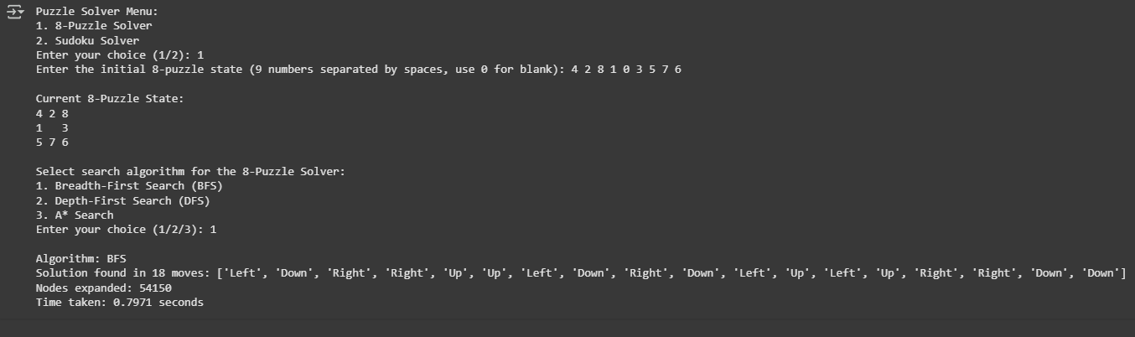
PERFORMANCE
8 PUZZLE
GROUP 4
SUAIBA BINTE SALAM
MD MARUF RAHMAN
AK FAIZUL HAQUE KONOK

Slide 8
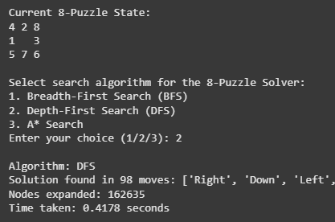
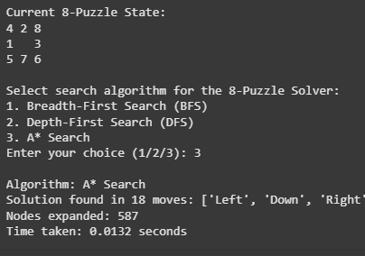
PERFORMANCE
8 PUZZLE
GROUP 4
SUAIBA BINTE SALAM
MD MARUF RAHMAN
AK FAIZUL HAQUE KONOK

Slide 9
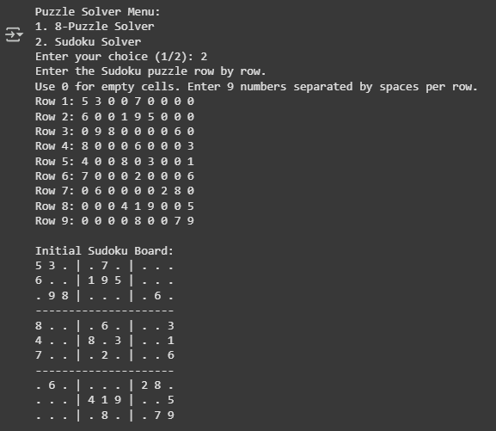
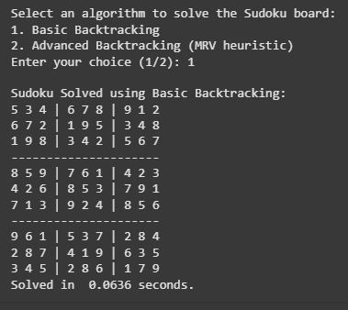
PERFORMANCE
SUDOKU
GROUP 4
SUAIBA BINTE SALAM
MD MARUF RAHMAN
AK FAIZUL HAQUE KONOK

Slide 10

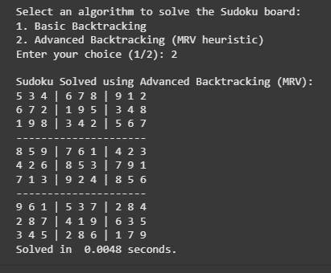
PERFORMANCE
SUDOKU
GROUP 4
SUAIBA BINTE SALAM
MD MARUF RAHMAN
AK FAIZUL HAQUE KONOK

Slide 11
CHALLENGES
THE PROJECT NEEDED TO SUPPORT BOTH THE 8-PUZZLE AND SUDOKU PUZZLES IN ONE CODEBASE
MUST TAKE USER INPUTS AND ALLOW USERS TO SELECT AN ALGORITHM
ROBUST USER INPUT HANDLING
MANAGING SEARCH LIMITS IN DFS
GROUP 4
SUAIBA BINTE SALAM
MD MARUF RAHMAN
AK FAIZUL HAQUE KONOK

Slide 12
SOLUTIONS
A MODULAR DESIGN WAS ADOPTED—SEPARATING THE 8-PUZZLE AND SUDOKU FUNCTIONALITIES INTO DISTINCT MODULES
THREE SEARCH ALGORITHMS WERE IMPLEMENTED TO SOLVE THE 8-PUZZLE, AND TWO OTHER ALGORITHMS WERE IMPLEMENTED TO SOLVE THE SUDOKU
TIME FUNCTIONS AND COUNTERS WERE INTEGRATED FOR THE USER TO COMPARE PERFORMANCES
TRY-EXCEPT BLOCKS AND VALIDATION LOGIC ENSURED THAT THE USER PROVIDED THE EXPECTED DATA FORMAT
ERROR MESSAGES WERE PROVIDED WHEN THE INPUT WAS INVALID, ALLOWING THE USER TO RETRY.
GROUP 4
SUAIBA BINTE SALAM
MD MARUF RAHMAN
AK FAIZUL HAQUE KONOK

Slide 13
CONCLUSION
WE SUCCESSFULLY DEVELOPED A PUZZLE SOLVER THAT IS CAPABLE OF TACKLING BOTH THE 8-PUZZLE AND SUDOKU CHALLENGES. BY IMPLEMENTING A VARIETY OF ALGORITHMS AND HEURISTICS, WE PROVIDED USERS WITH FLEXIBLE AND EFFICIENT SOLUTIONS. THE MODULAR DESIGN ENSURES THAT THE CODE IS EASY TO MAINTAIN AND EXPAND IN THE FUTURE. THIS PROJECT NOT ONLY ACHIEVED ITS OBJECTIVES BUT ALSO ESTABLISHED A STRONG FOUNDATION FOR FURTHER EXPLORATION OF PUZZLE-SOLVING ALGORITHMS AND THEIR APPLICATIONS
GROUP 4
SUAIBA BINTE SALAM
MD MARUF RAHMAN
AK FAIZUL HAQUE KONOK

Slide 14
THANK YOU FOR LISTENING
GROUP 4
SUAIBA BINTE SALAM
MD MARUF RAHMAN
AK FAIZUL HAQUE KONOK

